Slide 1


Slide 2
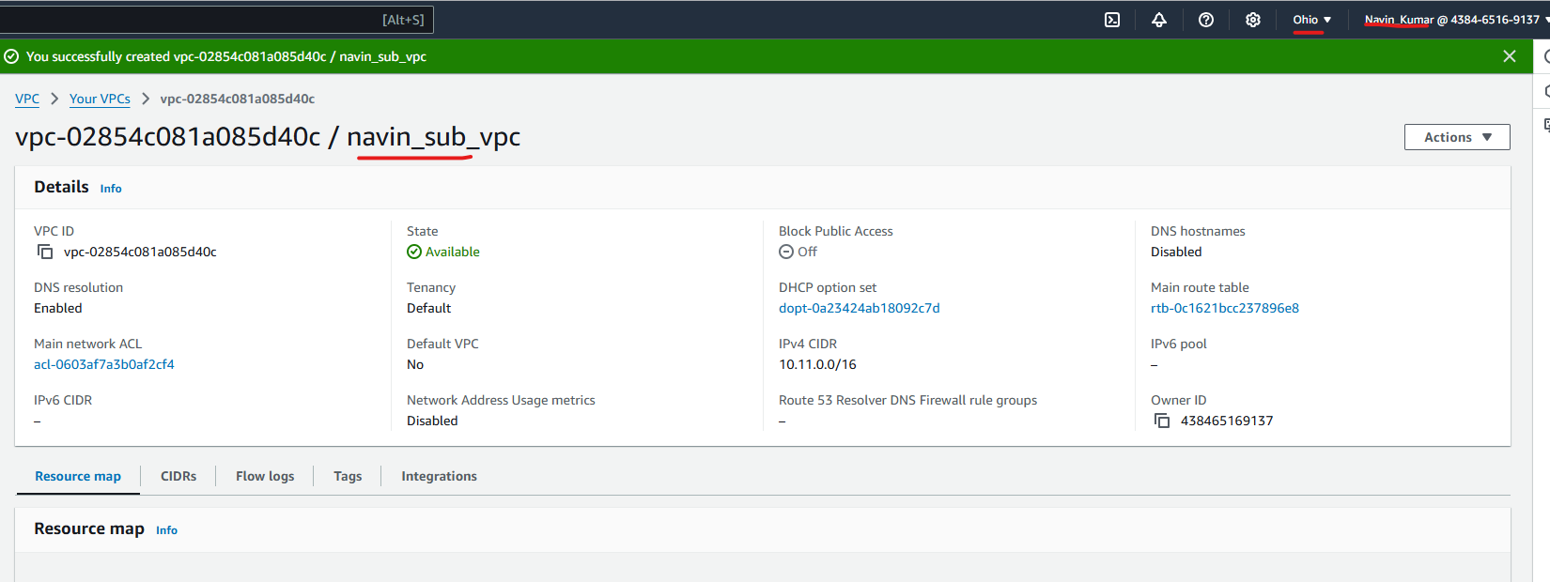

Slide 3
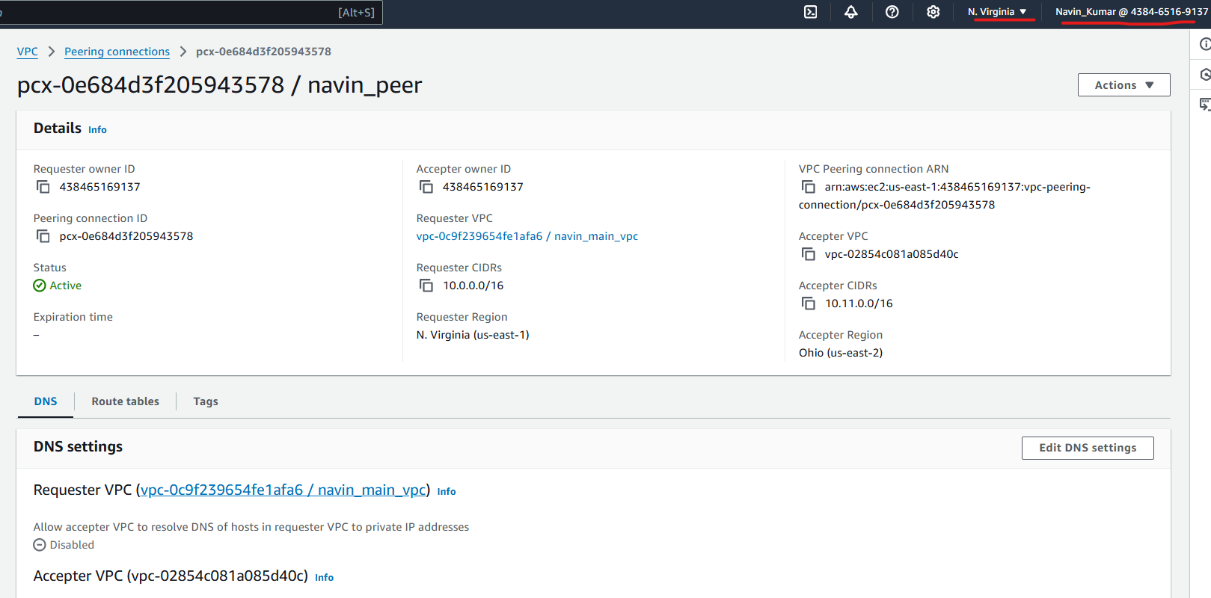

Slide 4

Main_Vpc

Slide 5

Sub _Vpc

